Slide 1
Avoiding COVID-19 in Colombia by taking USA and Korea meassures

Slide 2
Problem description
Colombia is one of the last countries to get the virus, the president is interested to know how the virus has been affecting the most important and the most affected countries to understand how the virus has grown there. As Korea had shown a big number of confirmed cases, and they also have been showing a decreasing number of cases in the last days, the president will take this Country as an example. So, he would like to understand what they have been doing so, he can establish some of their strategies in Colombia to avoid the massive increase of people sick by COVID 19. This is important because Colombia does not have a strong medical service, so to avoid the major number of infections is a priority.
On the other hand, we will use the opposite example of Korea: USA. This country has shown an increasing number of confirmed cases. So it will be interesting to compare the strategies of each country to give a complete idea to the president of what is the best decision to take given the situation.

Slide 3
Objective
As it is well known, quarantine has been the solution that has been showing the best results. However, there are different strategies around the world to close differents social places. Here I will be using Foursquare to compare the most visited places in Korea, Colombia, and USA to see how the countries are similar and if the strategies that Korea had applied can be applied in Colombia. On the other hand, it might be also interesting to see how USA has been managing their most popular places and contrast it with Korea so we can see if there is a possible social area that has not been closed and it could be a redpoint of infections.
Clustering the favorites places of each country we can see if there is a possibility to apply the strategy applied for Korea and to see if there is someplace in common that Korea has closed and might not be close by USA and it could show us the focus of a possible point contagion. So the president will see the necessity to close it so Colombia can go closer to the Korea results and avoid the increment numbers of cases.

Slide 4
Data
Data provided by HDX
Data show the record of confirmed cases of COVID-19 around the world, we will use data from Korea,USA and Colombia.
Data is conformed by: State, Country, Latitude, Longitude, time series of the cases up today.
We will use this data to compare how the virus had affected the countries selected.
Data provided by Foursqueare
Favorites places on different neighborhoods of each Country.
Then we will use this info to cluster the data and see if there is some similarities between countries so we can applied the strategy applied by Korea.

Slide 5
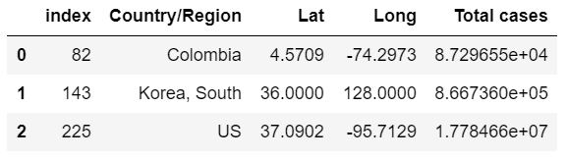
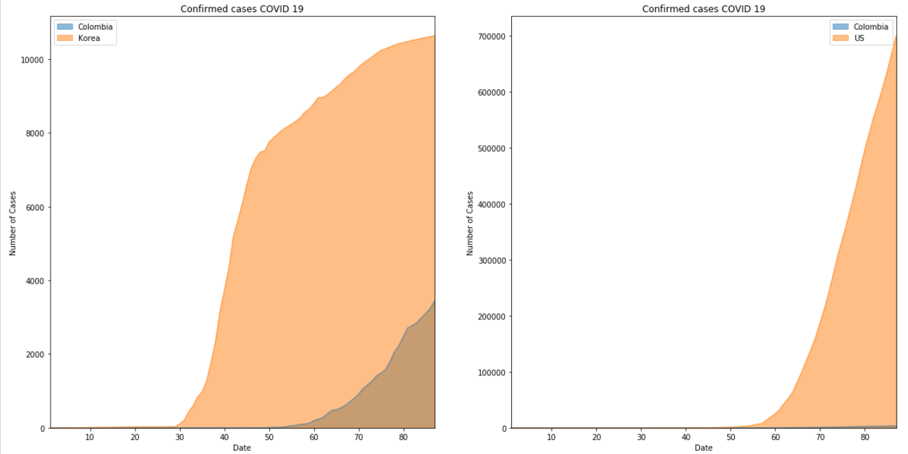
Comparing USA, COLOMBIA and KOREA

Slide 6
First Statement
With the graphs is possible to see what was established at the beginning.
Korea is a country that is showing and improvement by having a decrease in the number of confirmed cases.
US is an opposite example of Korea. They have been showing an increasing number of confirmed cases.
Now, once we have a good example of how to go against the Virus and an opposite example of it, we can study how similar the countries are so we can apply or not their strategies.

Slide 7
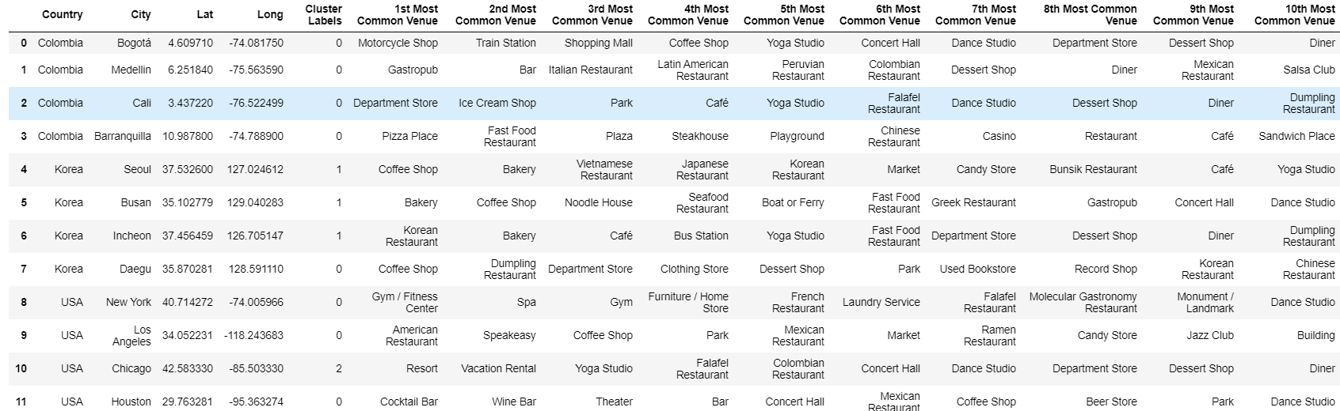
Clustering
Now we take the most important cities in each country and find the top 10 most important places given by Foursquare. This Will help us to analyze how similar are the countries and we can use their strategies or not.

Slide 8
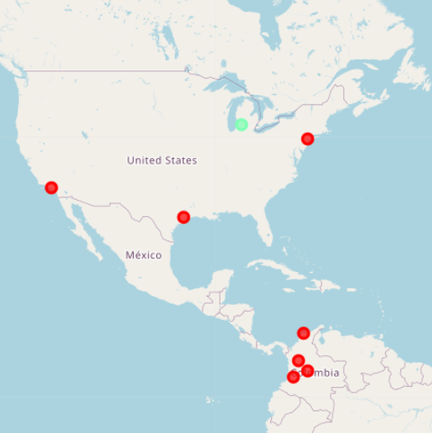
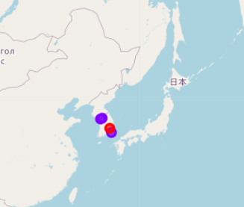
Clustering
3 Clusters

Slide 9
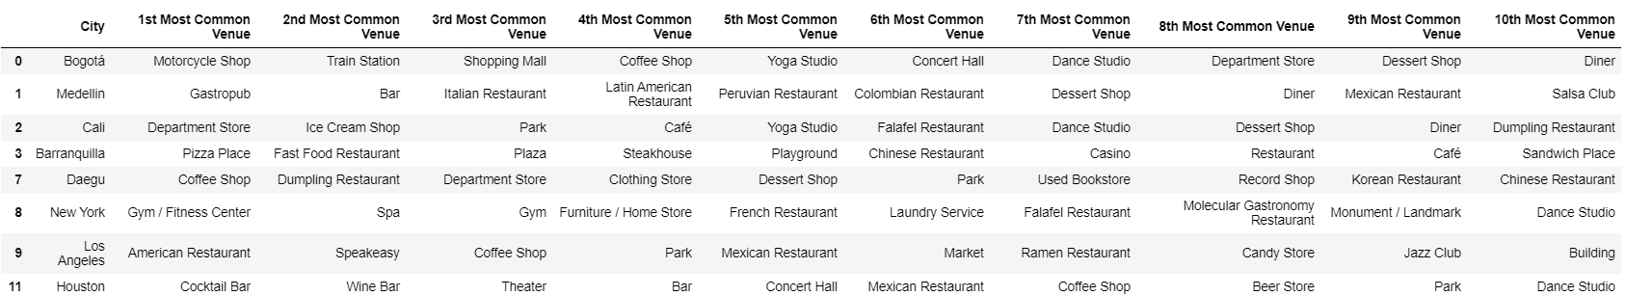
Cluster analysis
Cluster 1
Here we can see places that are common to have crowds, as is the gym, Bars, malls.

Slide 10
Cluster analysis
Cluster 2
Here we can see places that are common to have crowds, as is the gym, Bars, malls.

Slide 11
Cluster analysis
Cluster 3
Finally, Chicago is cluster by himself. It is because the places he has most common visited are more tourist sites.

Slide 12
Discussion
The first thing we can see is that the places that are preferred by each city speak about the culture of each one. And it actually can tell us about the improvement in Korea. It is easier to close little places that are no so crowd and places that the people do not go to full it. It is easier to contain people so they don't go to places like the coffee shop, bakery or restaurants. Even though if the people go, as they are not places full of people, it would not represent a redpoint for the virus. However, when you talk about malls, fast food places, gyms, bars, and add to it cultures as the Colombian and American is: more activate people who enjoy the gatherings and loudly places, it is different because it would be hardest to contain people to go to this places. And meanwhile, the lockdown is imposed, if people go to any of these places, this would represent an exponential problem and a redpoint for the virus. In conclusion, is more complicated to have control in more active countries and countries that are represented by cultures that enjoy gatherings.
So, what we can conclude to the president is that Korea has been showing good results but not just for the lockdown imposed, but for the culture and the way people think about social places. For them, it is not essential to be with a big group of friends in a full place. So he would have to make aware the people about this and how important is to avoid crowds.
As the difference of the Korean people's culture could not help us by telling about how the lockdown improves the numbers of confirmed cases (because of the differences of the top venues in each country), the exercise we did con USA can tell us more. Colombian people know because they like gatherings and to join people everywhere. As the cluster shows, USA also has a representative number of places who are most know because of the great number of people there. And taking into count the ascending number of cases and having a context that US does not take any lockdown measures, we can confirm that these places are a focus for the virus and the best will be to close them.

Slide 13
Conclusion
The purpose of this project was to give support advice to the president of Colombia on how to go through the situation of the virus: COVID- 19. The principal idea was to take Korea as a good example of measures applied because of their clear decreasing of confirmed cases in the last days. On the other hand, we had USA, a country that has not been able to contain the virus and their confirmed cases have been growing in the last days.
The first sight of the problem told us that we can have a great idea of how to contain the virus having the control that Korea had applied to contained the virus. However, as we cluster the most common places in the countries, we saw a clear grouping of places that can give us the idea of how different the Korea culture is. They appear to go to more quiet places that are no so crowd. So we can not get any more than giving to Colombian people this way to think: the importance of avoiding places that usually have a lot of people and how this could show results. Despite this, we found too many common places with USA, and as we saw the had been showing a great number of confirmed cases, we can conclude that it is essential to close these places as they are not essential. The president can take the bad numbers of US to avoid doing what they have not: the closing of public places.

